Slide 1
The What to Look for in a Child-Centred CNC Program Webinar will begin shortly

Slide 2
What to Look for in a Child-Centred CNC Program Webinar
This 1-hour webinar will provide CNC administrators with a basic overview of the key elements that come together to make quality, child-centred care.
Administrators will have the opportunity to discuss:
-child-centred care and how it improves quality
-what to look for in their CNC program to ensure that newcomer children and parents are receiving the quality care and support they need.
Participants will also be provided with a helpful checklist to use in their CNC program!
Rachel Brophy
Ph.D., RECE

Slide 3
What to look for in a child-centred CNC program
Rachel Brophy
Ph.D., RECE

Slide 4
Introduction & welcome
What do we mean by child-centred practice or a child-centred program?
What is quality care?
What is the relationship between quality and child-centred practice?
A helpful checklist: What are we actually looking for?
Resources
Summary and Reflection Questions

Slide 5
What is a
child-centred program?

Slide 6
Definition of Child-centred:
A child-centred program places the child at the centre of their learning process. The child is an active participant in their own learning. The program is play-based, the child has choices of learning activities, the families are seen as knowledgeable and important, and the educator acts as a facilitator of learning.

Slide 7
A child-centred approach and early learning framework
Every province in Canada has developed an Early Learning Framework
Each framework acts a guide for supporting principles around curriculum and pedagogy and early years programming for that particular province/territory
All of these frameworks share a child-centred perspective that address the image of the child, the family and community, the educator and the early learning environment

Slide 8
More ways to understand child-centred practice ~ samples from provincial Early Learning Frameworks ~
“An early learning and child care curriculum framework is different than a traditional curriculum. In early childhood, curriculum is focused on broad holistic goals rather than specific outcomes for each subject area. Early learning and child care curriculum frameworks embrace children’s everyday experiences as the sources of curriculum meaning making. Early childhood educators use the goals in the curriculum framework to describe and interpret children’s everyday experiences. In early childhood, curriculum content is integrated, emerging from children’s fascination with the world. When educators notice children’s interest in exploring nature, people, places, and objects as well as print, stories, numbers, shapes, and patterns, and when they name the connections between these experiences and early literacy, mathematics, science, social studies, music, and art, they are co-constructing early learning curriculum with young children and making the curriculum visible to others.”
Alberta: Play, Participation, and Possibilities (p. 12)

Slide 9
More ways to understand child-centred practice ~ some samples from provincial Early Learning Frameworks ~
“During the early years, children’s tremendous capacity to learn is enhanced when they experience nurturing environments, and are able to actively explore their worlds through play. Children expand their learning with every experience, every interaction, and every observation they make. In Early Years Centres, the learning environment is carefully and thoughtfully designed to encourage opportunities for creative investigation and exploration. In Early Years Centres, children are encouraged to make new discoveries, actively pursue their interests, ask questions, solve problems, and develop a lifelong love and excitement for learning.”
Prince Edward Island: PEI Early Learning Framework (p.5)

Slide 10
More ways to understand child-centred practice ~ some samples from provincial Early Learning Frameworks ~
“Children are competent, capable of complex thinking, curious, and rich in potential. They grow up in families with diverse social, cultural, and linguistic perspectives. Every child should feel that he or she belongs, is a valuable contributor to his or her surroundings, and deserves the opportunity to succeed. When we recognize children as capable and curious, we are more likely to deliver programs and services that value and build on their strengths and abilities.”
Ontario: How Does Learning Happen? Ontario’s Pedagogy for the Early Years (p. 6)

Slide 11
Common elements across
Canada’s early learning frameworks
Importance of play
Relationships
Environment as a teacher
Everyday experiences
Continuity of care
Inclusion, Diversity, Belonging
Image of the child, family, educator, community

Slide 12
What is
Quality Care?

Slide 13
Multiple Perspectives on Quality
Top-down perspective
Bottom up perspective
Take the children’s perspective
Inside perspective
Outside - inside
Outside perspective
(Katz, 1993)

Slide 14
Quality care
Qualified Staff:
appropriate staff-child interactions
knowledge of child development & curriculum
consistent staffing
Standards relating to:
appropriate physical setting
established procedures (i.e. emergency/fire)
nutritional meals
developmentally appropriate and meaningful curriculum and expectations

Slide 15
Components of Quality
Dynamic - Children’s daily experiences based on relationships
Framework - Structural components that define the social and physical environment
Context - Environment outside of the early learning environment that influences the framework & dynamic components
Essentials of Early Childhood Education
Gestwicki & Bertrand (2012)

Slide 16
Benefits of Quality Care
Supports early development and provides life-long benefits
Enables parental education, employment, settlement and satisfaction
Creates a family resource & support system

Slide 17
What is Quality Care about?
“It’s about warmth and caring and interesting things to do. It’s about high self-esteem and genuine concerns about the quality of everyone's day. It’s about playing games and singing songs and play house and holding and laughing and having a nice time. It is about everyone being accepted and respected without reservation - and telling each other this in lots of ways. It’s about overlooking transgressions to we can get on with the things that really count. It’s about children and adults spending the day together and looking forward to spending tomorrow together too.”
Caregiver’s Corner. What is Quality Child Care About? Allen, J. (1991)

Slide 18
What is the relationship between quality and child-centred care?
What does this look like in practice?
What are we actually looking for?

Slide 19
The environment ensures …
Safety
Accessibility
Perspective of children
Play-based learning
Aesthetics
Movement
Belonging
Organization
Flexibility
Predictability

Slide 20
The curriculum is …
Responsive
Developmentally appropriate
Play-based
Encouraging curiosity, inquiry, exploration
Meaningful and relevant – creating a sense of belonging
Based on observations
Supporting children’s needs, interests
Both planned and spontaneous
Flexible

Slide 21
The interactions are …
Always growing and developing
Respectful
Supportive and facilitate learning and development
Open, kind
Playful
Curious
Responsive
Nurturing
Promoting well being

Slide 22
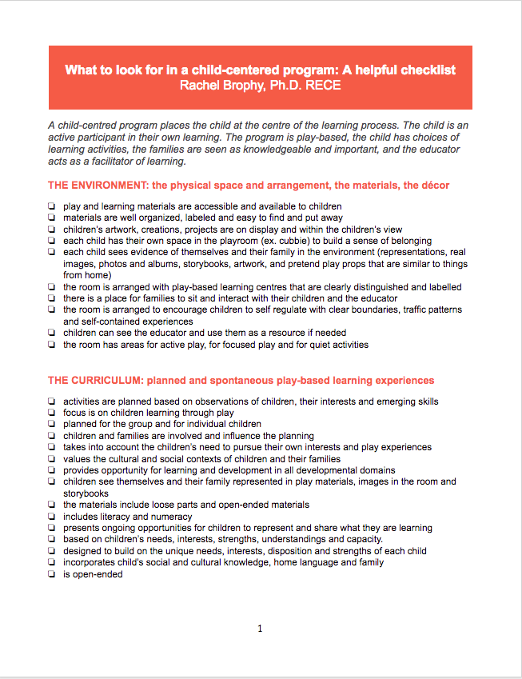
What to look for in a child-centred CNC program: A helpful checklist

Slide 23
Canada’s Early Learning Frameworks
Play, Participation, and Possibilities: An Early Learning and Child Care Curriculum Framework for Alberta
British Columbia Early Learning Framework
Play and Exploration Early Learning Program Guide for Saskatchewan
How Does Learning Happen? Ontario's Pedagogy for the Early Years
Meeting Early Childhood Needs. Quebec's Educational Program for Childcare Services
Early Childhood Learning. Newfoundland and Labrador
PEI Early Learning Framework. Relationships, Environments. Experiences
Early Returns. Manitoba’s Early Learning and Child Care Curriculum Framework for Preschool Centres and Nursery Schools
Northwest Territories (NWT) Framework for Early Childhood Development: Right from the Start
Indigenous Early Learning and Child Care Framework

Slide 24
Some Additional Resources
Quality By Design
The Childcare Resource and Research Unit
Play-based Learning in the Encylopedia on Early Childhood Development
Play-based learing in a culture of inquiry. Ontario's Kindergarten Program
Finding Quality Childcare

Slide 25
In conclusion
A summary of what was discussed today:
Child-centred practice
Quality care
The relationship between child-centred practice and quality care
What a child-centred program looks like in terms of:
Environment
Curriculum
interactions
A helpful checklist

Slide 26
Some questions for reflection …
How can you best support CNC staff to create and maintain a child-centred program?
What are some challenges you may encounter when working to ensure a child-centred program? How might you address these challenges and find solutions or understanding?
What additional information or resources might you find helpful as you continue to build knowledge and understanding of a child-centred approach?

Slide 27
Thank you!
I look forward to
receiving your questions.

